Slide 1
PHP
Dr. Sandeep Kumar Satapathy

Slide 2
PHP Echo
PHP echo is a language construct, not a function.
Therefore, you don't need to use parenthesis with it.
But if you want to use more than one parameter, it is required to use parenthesis.
The syntax of PHP echo is given below:
void echo ( string $arg1 [, string $... ] )

Slide 3
PHP Echo
PHP echo statement can be used to print the string, multi-line strings, escaping characters, variable, array, etc. Some important points that you must know about the echo statement are:
echo is a statement, which is used to display the output.
echo can be used with or without parentheses: echo(), and echo.
echo does not return any value.
We can pass multiple strings separated by a comma (,) in echo.
echo is faster than the print statement.

Slide 4
Echo - Example
PHP echo: printing string
File: echo1.php
<?php
echo "Hello by PHP echo";
?>
Output:
Hello by PHP echo
PHP echo: printing multi line string
File: echo2.php
<?php
echo "Hello by PHP echo
this is multi line
text printed by
PHP echo statement
";
?>
Output:
Hello by PHP echo this is multi line text printed by PHP echo statement

Slide 5
Echo - Example
PHP echo: printing escaping characters
File: echo3.php
<?php
echo "Hello escape \"sequence\" characters";
?>
Output:
Hello escape "sequence" characters
PHP echo: printing variable value
File: echo4.php
<?php
$msg="Hello Welcome to PHP";
echo "Message is: $msg";
?>
Output:
Message is: Hello Welcome to PHP

Slide 6
PHP Print
Like PHP echo, PHP print is a language construct, so you don't need to use parenthesis with the argument list.
Print statement can be used with or without parentheses: print and print(). Unlike echo, it always returns 1.
The syntax of PHP print is given below:
int print(string $arg)

Slide 7
PHP Print
PHP print statement can be used to print the string, multi-line strings, escaping characters, variable, array, etc.
Some important points that you must know about the echo statement are:
print is a statement, used as an alternative to echo at many times to display the output.
print can be used with or without parentheses.
print always returns an integer value, which is 1.
Using print, we cannot pass multiple arguments.
print is slower than the echo statement.

Slide 8
Print - Example
PHP print: printing string
File: print1.php
<?php
print "Hello by PHP print ";
print ("Hello by PHP print()");
?>
Output:
Hello by PHP print Hello by PHP print()
PHP print: printing multi line string
File: print2.php
<?php
print "Hello by PHP print
this is multi line
text printed by
PHP print statement
";
?>
Output:
Hello by PHP print this is multi line text printed by PHP print statement

Slide 9
Print - Example
PHP print: printing escaping characters
File: print3.php
<?php
print "Hello escape \"sequence\" characters by PHP print";
?>
Output:
Hello escape "sequence" characters by PHP print
PHP print: printing variable value
File: print4.php
<?php
$msg="Hello print() in PHP";
print "Message is: $msg";
?>
Output:
Message is: Hello print() in PHP

Slide 10
PHP Variable Scope
The scope of a variable is defined as its range in the program under which it can be accessed.
In other words, "The scope of a variable is the portion of the program within which it is defined and can be accessed."
PHP has three types of variable scopes:
Local variable
Global variable
Static variable

Slide 11
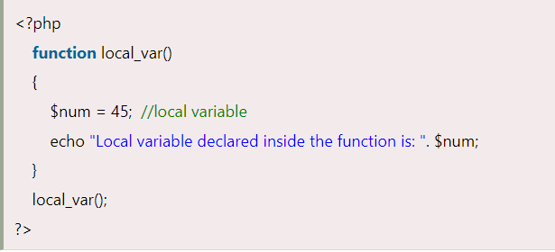
Local Variable
Output:
Local variable declared inside the function is: 45

Slide 12
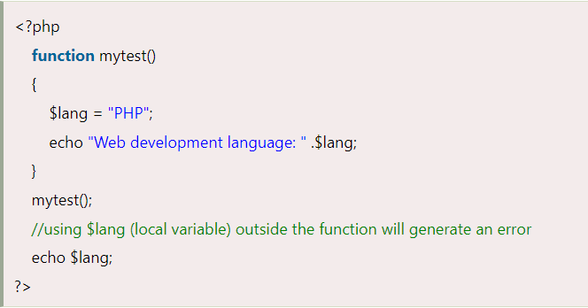
Local Variable
Output:
Web development language: PHP
Notice: Undefined variable: lang in D:\xampp\htdocs\program\p3.php on line 28

Slide 13
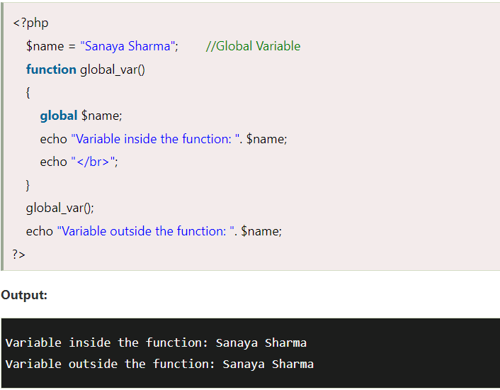
Global Variable

Slide 14
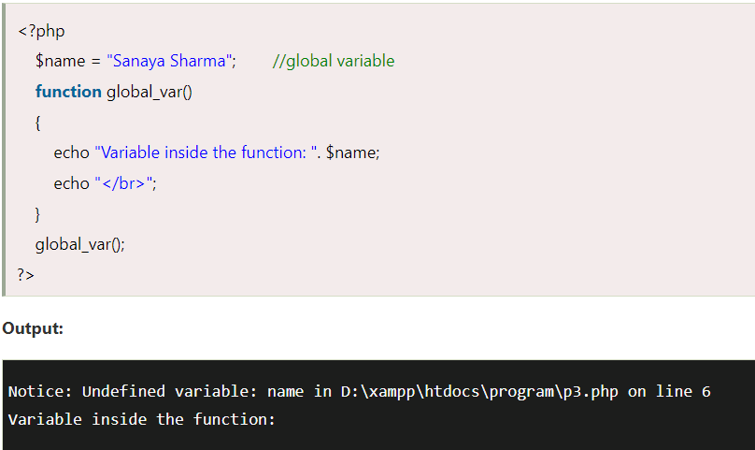
Global Variable

Slide 15
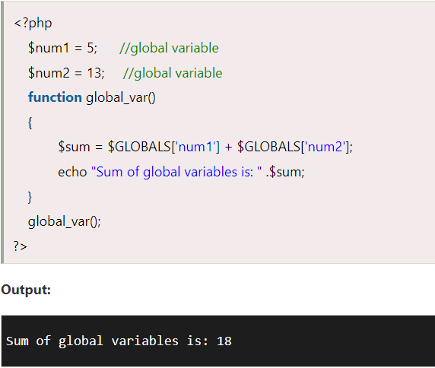
Using $GLOBALS instead of global

Slide 16
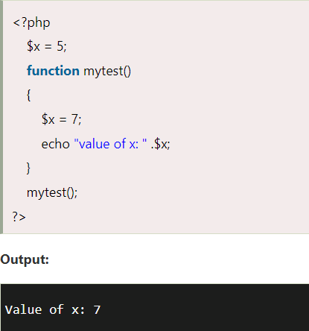
If two variables, local and global, have the same name, then the local variable has higher priority than the global variable inside the function.

Slide 17
Static Variable
It is a feature of PHP to delete the variable, once it completes its execution and memory is freed.
Sometimes we need to store a variable even after completion of function execution.
Therefore, another important feature of variable scoping is static variable.
We use the static keyword before the variable to define a variable, and this variable is called as static variable.
Static variables exist only in a local function, but it does not free its memory after the program execution leaves the scope.

Slide 18
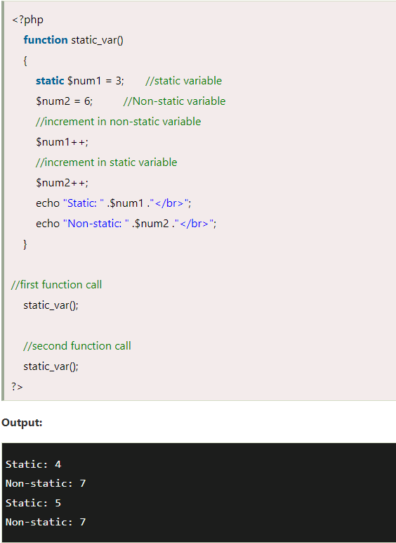
Static Variable

Slide 19
PHP $ and $$ Variables
The $var (single dollar) is a normal variable with the name var that stores any value like string, integer, float, etc.
The $$var (double dollar) is a reference variable that stores the value of the $variable inside it.
To understand the difference better, let's see some examples.

Slide 20
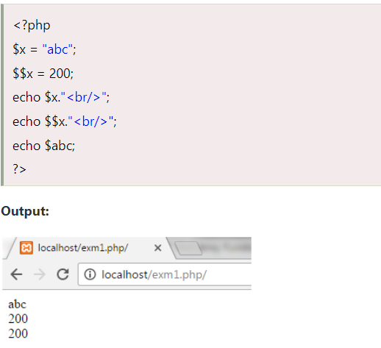
PHP $ and $$ Variables

Slide 21
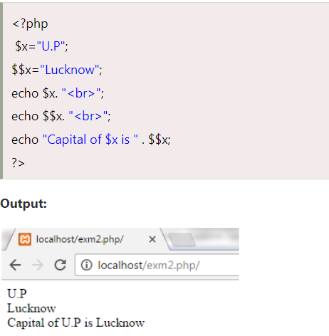
Example

Slide 22
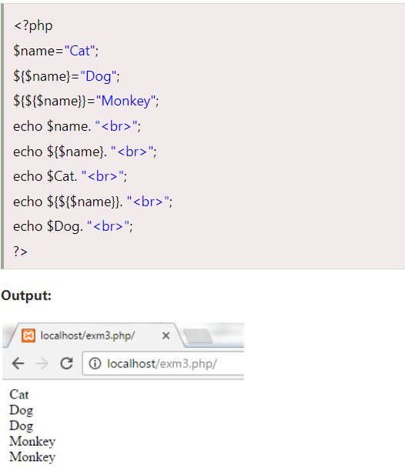
Example

Slide 23
PHP Constants
PHP constants are name or identifier that can't be changed during the execution of the script except for magic constants, which are not really constants. PHP constants can be defined by 2 ways:
Using define() function
Using const keyword

Slide 24
PHP Constants
Constants are similar to the variable except once they defined, they can never be undefined or changed.
They remain constant across the entire program. PHP constants follow the same PHP variable rules.
For example, it can be started with a letter or underscore only.
Conventionally, PHP constants should be defined in uppercase letters.

Slide 25
PHP constant: define()
Use the define() function to create a constant.
It defines constant at run time. Let's see the syntax of define() function in PHP.
define(name, value, case-insensitive)
name: It specifies the constant name.
value: It specifies the constant value.
case-insensitive: Specifies whether a constant is case-insensitive. Default value is false. It means it is case sensitive by default.

Slide 26
Example
<?php
define("MESSAGE","Hello Welcome to PHP");
echo MESSAGE;
?>
Output:
Hello Welcome to PHP
Create a constant with case-insensitive name:
<?php
define("MESSAGE","Hello Welcome to PHP",true);//not case sensitive
echo MESSAGE, "</br>";
echo message;
?>
Output:
Hello Welcome to PHP Hello Welcome to PHP

Slide 27
Example
<?php
define("MESSAGE","Hello Welcome to PHP",false);//case sensitive
echo MESSAGE;
echo message;
?>
Output:
Hello Welcome to PHP
Notice: Use of undefined constant message - assumed 'message' in C:\wamp\www\vconstant3.php on line 4 message

Slide 28
PHP constant: const keyword
PHP introduced a keyword const to create a constant.
The const keyword defines constants at compile time.
It is a language construct, not a function.
The constant defined using const keyword are case-sensitive.

Slide 29
Example
<?php
const MESSAGE="Hello const by PHP";
echo MESSAGE;
?>
Output:
Hello const by PHP

Slide 30
Constant() function
There is another way to print the value of constants using constant() function instead of using the echo statement.
Syntax
The syntax for the following constant function:
constant (name)
<?php
define("MSG", “Welcome");
echo MSG, "</br>";
echo constant("MSG");
//both are similar
?>
Output:
Welcome Welcome

Slide 31
PHP Data Types
PHP data types are used to hold different types of data or values. PHP supports 8 primitive data types that can be categorized further in 3 types:
Scalar Types (predefined)
Compound Types (user-defined)
Special Types

Slide 32
PHP Data Types: Scalar Types
It holds only single value. There are 4 scalar data types in PHP.
boolean
integer
float
string

Slide 33
PHP Data Types: Compound Types
It can hold multiple values. There are 2 compound data types in PHP.
array
object

Slide 34
PHP Data Types: Special Types
There are 2 special data types in PHP.
resource
NULL

Slide 35
PHP Call By Value
PHP allows you to call function by value and reference both.
In case of PHP call by value, actual value is not modified if it is modified inside the function.
Let's understand the concept of call by value by the help of examples.

Slide 36
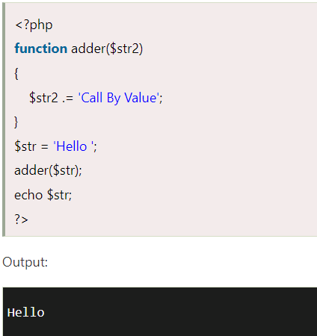
Example 1
In this example, variable $str is passed to the adder function where it is concatenated with 'Call By Value' string. But, printing $str variable results 'Hello' only. It is because changes are done in the local variable $str2 only. It doesn't reflect to $str variable.

Slide 37
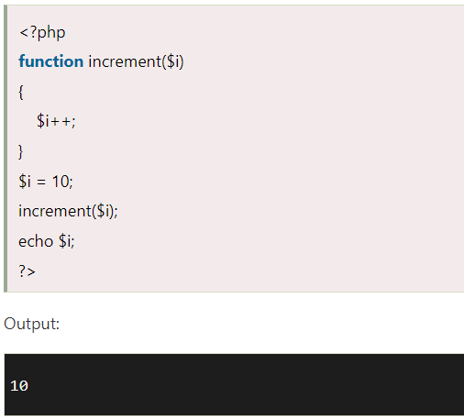
Example 2
Let's understand PHP call by value concept through another example.

Slide 38
PHP Call By Reference
In case of PHP call by reference, actual value is modified if it is modified inside the function.
In such case, you need to use & (ampersand) symbol with formal arguments. The & represents reference of the variable.
Let's understand the concept of call by reference by the help of examples.

Slide 39
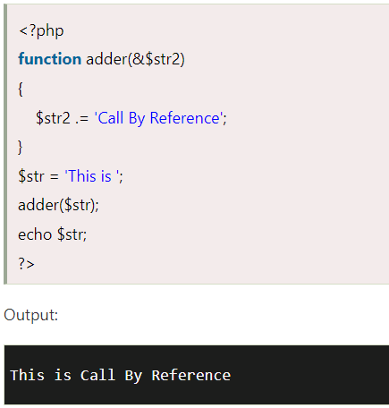
Example 1
In this example, variable $str is passed to the adder function where it is concatenated with 'Call By Reference' string. Here, printing $str variable results 'This is Call By Reference'. It is because changes are done in the actual variable $str.

Slide 40
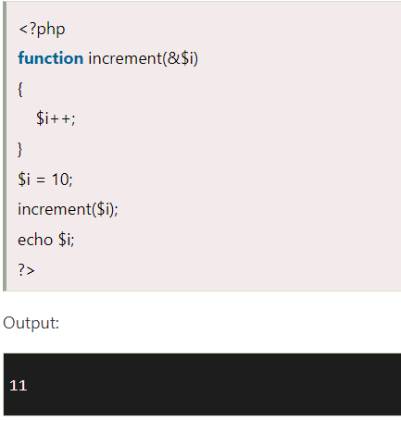
Example 2

Slide 41
PHP Default Argument Values Function
PHP allows you to define C++ style default argument values. In such case, if you don't pass any value to the function, it will use default argument value.
Let' see the simple example of using PHP default arguments in function.

Slide 42
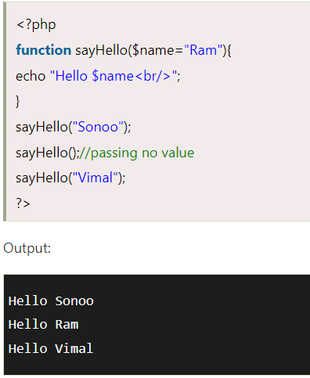
Example

Slide 43
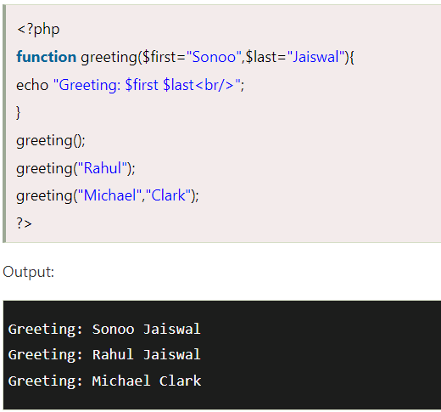
Example

Slide 44
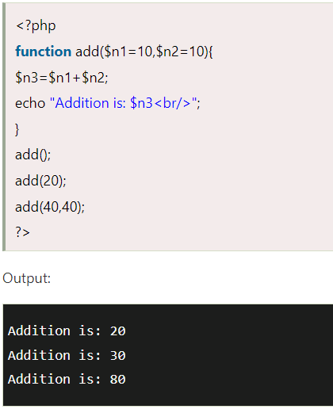
Example

Slide 45
PHP Variable Length Argument Function
PHP supports variable length argument function.
It means you can pass 0, 1 or n number of arguments in function.
To do so, you need to use 3 ellipses (dots) before the argument name.
The 3 dot concept is implemented for variable length argument since PHP 5.6.
Let's see a simple example of PHP variable length argument function.

Slide 46
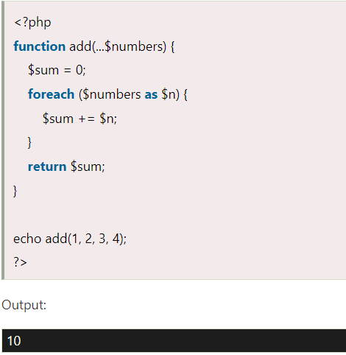
Example

Slide 47
PHP Recursive Function
PHP also supports recursive function call like C/C++.
In such case, we call current function within function. It is also known as recursion.
It is recommended to avoid recursive function call over 200 recursion level because it may smash the stack and may cause the termination of script.

Slide 48
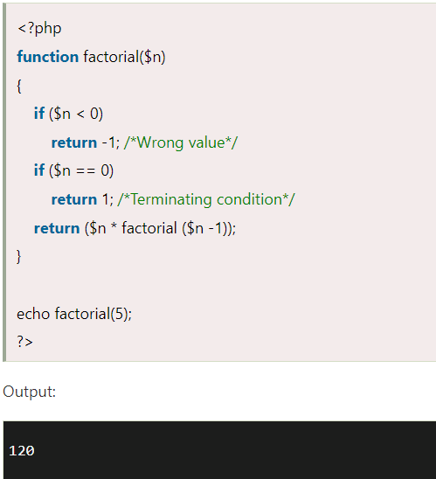
Example

Slide 49
PHP String
PHP string is a sequence of characters i.e., used to store and manipulate text.
PHP supports only 256-character set and so that it does not offer native Unicode support. There are 4 ways to specify a string literal in PHP.
single quoted
double quoted
heredoc syntax
newdoc syntax (since PHP 5.3)

Slide 50
Single Quoted
We can create a string in PHP by enclosing the text in a single-quote. It is the easiest way to specify string in PHP.
For specifying a literal single quote, escape it with a backslash (\) and to specify a literal backslash (\) use double backslash (\\). All the other instances with backslash such as \r or \n, will be output same as they specified instead of having any special meaning.
Following some examples are given to understand the single quoted PHP String in a better way:

Slide 51
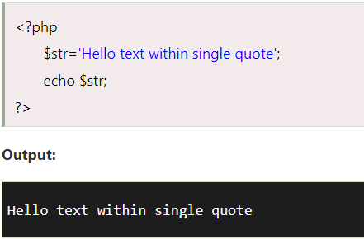
Example

Slide 52
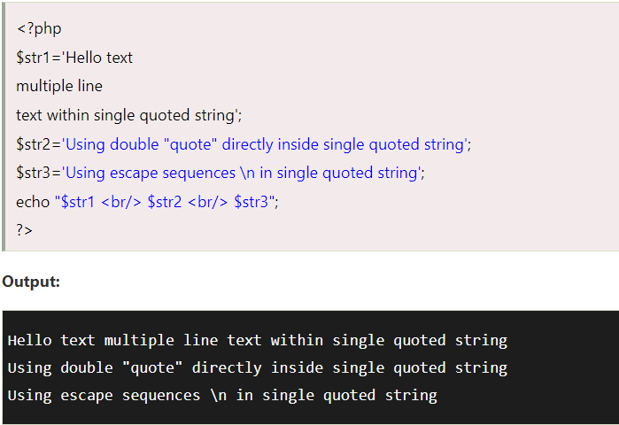
Example

Slide 53
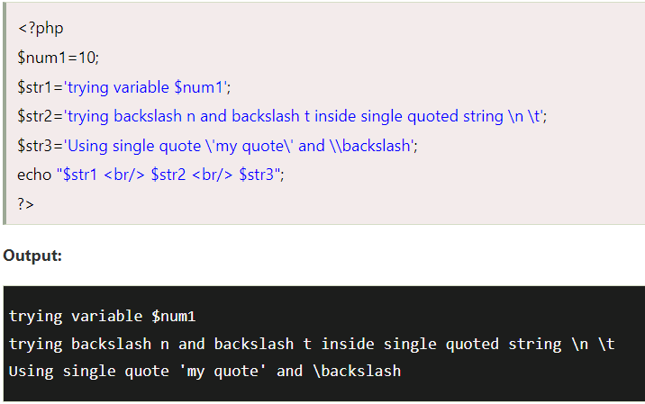
Example

Slide 54
Heredoc
Heredoc syntax (<<<) is the third way to delimit strings.
In Heredoc syntax, an identifier is provided after this heredoc <<< operator, and immediately a new line is started to write any text.
To close the quotation, the string follows itself and then again that same identifier is provided.
That closing identifier must begin from the new line without any whitespace or tab.
Naming Rules
The identifier should follow the naming rule that it must contain only alphanumeric characters and underscores, and must start with an underscore or a non-digit character.

Slide 55
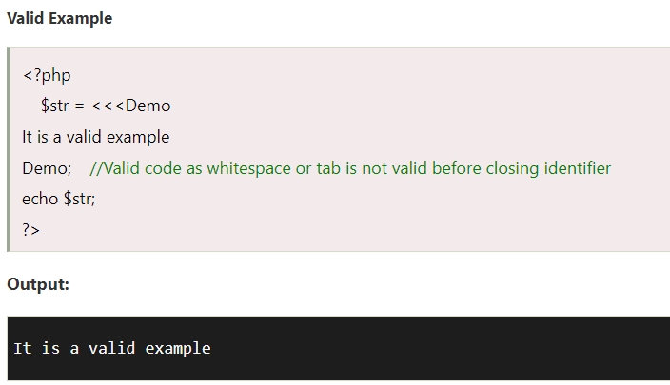
Example

Slide 56
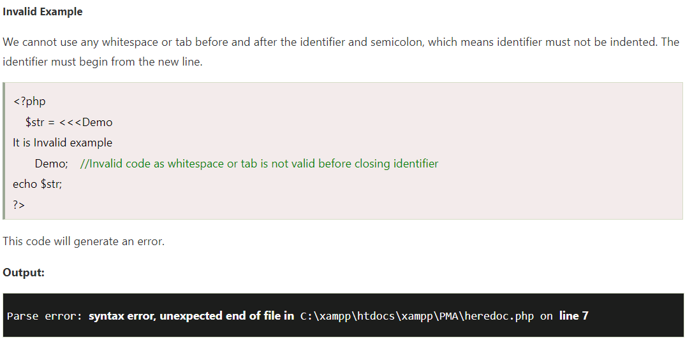
Example

Slide 57
Newdoc
Newdoc is similar to the heredoc, but in newdoc parsing is not done.
It is also identified with three less than symbols <<< followed by an identifier.
But here identifier is enclosed in single-quote, e.g. <<<'EXP'. Newdoc follows the same rule as heredocs.
The difference between newdoc and heredoc is that - Newdoc is a single-quoted string whereas heredoc is a double-quoted string.

Slide 58
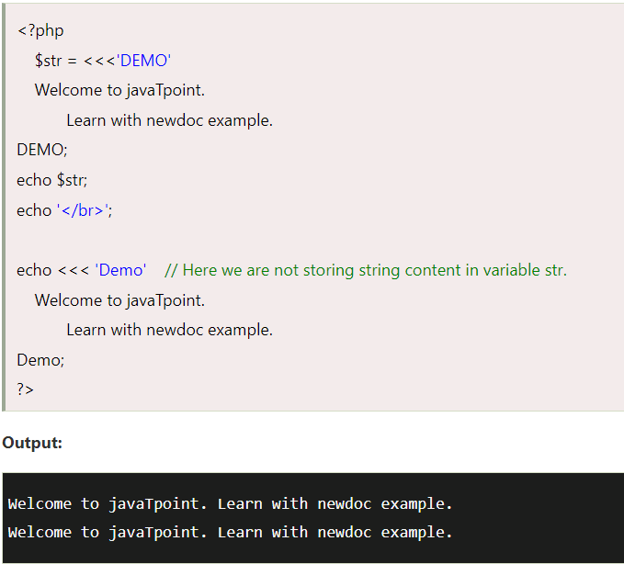
Example

Slide 59
PHP String Function Examples
PHP strtolower() function
The strtolower() function returns string in lowercase letter.
Syntax
string strtolower ( string $string )
Example
<?php
$str="My name is XYZ";
$str=strtolower($str);
echo $str;
?>
Output:
my name is xyz

Slide 60
PHP strtoupper() function
The strtoupper() function returns string in uppercase letter.
Syntax
string strtoupper ( string $string )
Example
<?php
$str="My name is XYZ";
$str=strtoupper($str);
echo $str;
?>
Output:
MY NAME IS XYZ

Slide 61
PHP ucfirst() function
The ucfirst() function returns string converting first character into uppercase. It doesn't change the case of other characters.
Syntax
string ucfirst ( string $str )
Example
<?php
$str="my name is xyz";
$str=ucfirst($str);
echo $str;
?>
Output:
My name is xyz

Slide 62
PHP ucwords() function
The ucwords() function returns string converting first character of each word into uppercase.
Syntax
string ucwords ( string $str )
Example
<?php
$str="my name is abc xyz";
$str=ucwords($str);
echo $str;
?>
Output:
My Name Is Abc Xyz

Slide 63
PHP strrev() function
The strrev() function returns reversed string.
Syntax
string strrev ( string $string )
Example
<?php
$str="my name is xyz";
$str=strrev($str);
echo $str;
?>
Output:
zyx si eman ym

Slide 64
PHP strlen() function
The strlen() function returns length of the string.
Syntax
int strlen ( string $string )
Example
<?php
$str="my name is xyz";
$str=strlen($str);
echo $str;
?>
Output:
14

Slide 65
PHP Math
PHP provides many predefined math constants and functions that can be used to perform mathematical operations.
PHP Math: abs() function
The abs() function returns absolute value of given number. It returns an integer value but if you pass floating point value, it returns a float value.

Slide 66
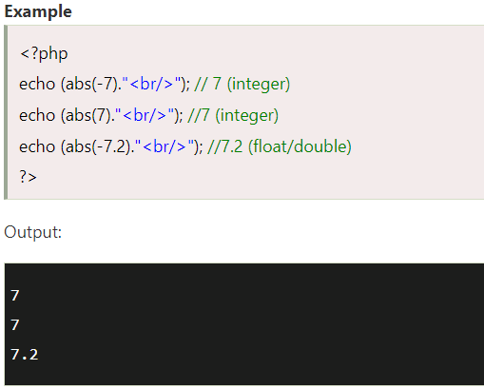
Example

Slide 67
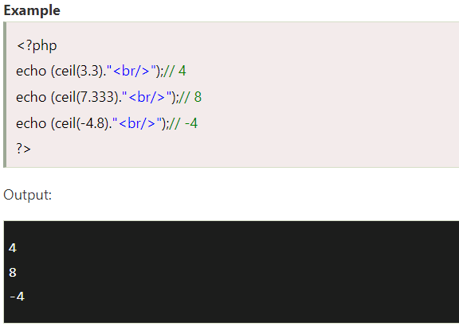
ceil()

Slide 68
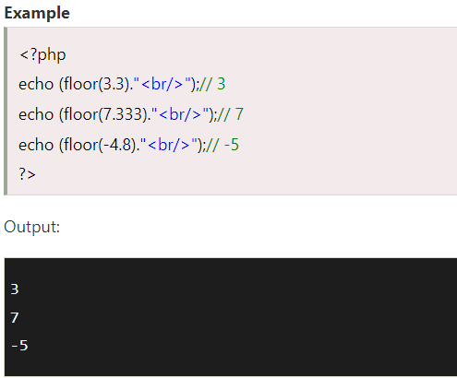
floor()

Slide 69
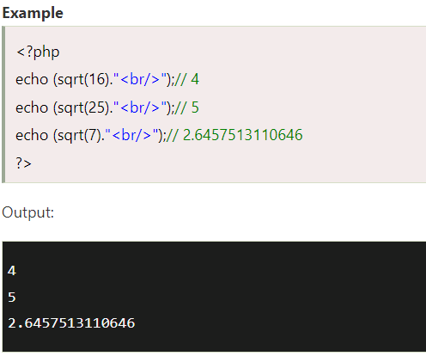
sqrt()

Slide 70
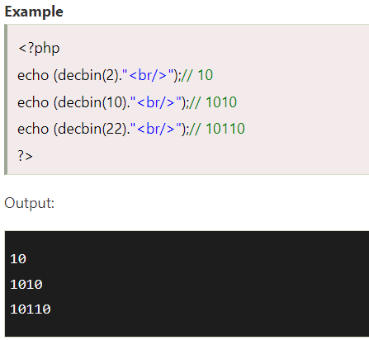
decbin()

Slide 71
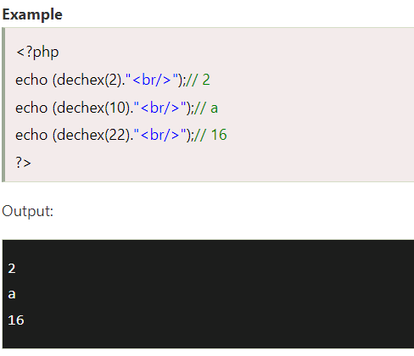
dechex()

Slide 72
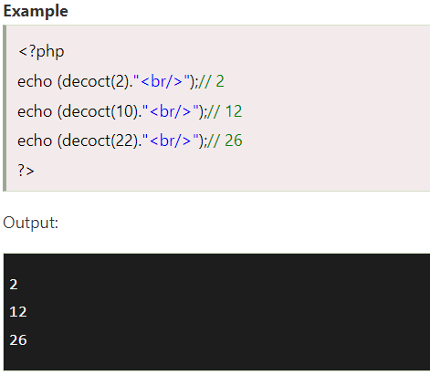
decoct()

Slide 73
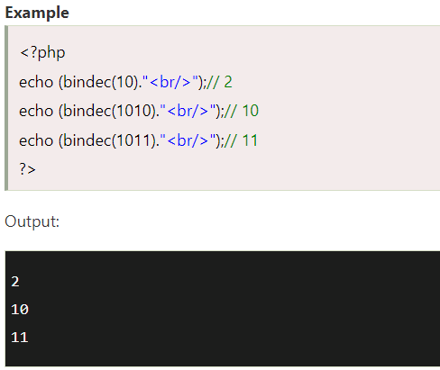
bindec()

Slide 74
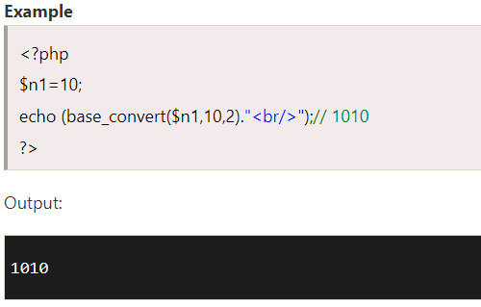
PHP Math: base_convert() function
The base_convert() function allows you to convert any base number to any base number.
For example, you can convert hexadecimal number to binary, hexadecimal to octal, binary to octal, octal to hexadecimal, binary to decimal etc.

Slide 75
PHP Include and Require
PHP allows us to create various elements and functions, which are used several times in many pages.
It takes much time to script these functions in multiple pages.
Therefore, use the concept of file inclusion that helps to include files in various programs and saves the effort of writing code multiple times.

Slide 76
PHP Include and Require
"PHP allows you to include file so that a page content can be reused many times.
It is very helpful to include files when you want to apply the same HTML or PHP code to multiple pages of a website." There are two ways to include file in PHP.
include
require

Slide 77
PHP Include and Require
Both include and require are identical to each other, except failure.
include only generates a warning, i.e., E_WARNING, and continue the execution of the script.
require generates a fatal error, i.e., E_COMPILE_ERROR, and stop the execution of the script.
Advantage
Code Reusability: By the help of include and require construct, we can reuse HTML code or PHP script in many PHP scripts.
Easy editable: If we want to change anything in webpages, edit the source file included in all webpage rather than editing in all the files separately.

Slide 78
PHP include
PHP include is used to include a file on the basis of given path. You may use a relative or absolute path of the file.
Syntax
There are two syntaxes available for include:
include 'filename ';
Or
include ('filename');

Slide 79
Examples
Let's see a simple PHP include example.
File: menu.html
<a href="http://www.java.com">Home</a> |
<a href="http://www.java.com/php-tutorial">PHP</a> |
<a href="http://www.java.com/java-tutorial">Java</a> |
<a href="http://www.java.com/html-tutorial">HTML</a>
File: include1.php
<?php include("menu.html"); ?>
<h1>This is Main Page</h1>

Slide 80
PHP require
PHP require is similar to include, which is also used to include files. The only difference is that it stops the execution of script if the file is not found whereas include doesn't.
Syntax
There are two syntaxes available for require:
require 'filename';
Or
require ('filename');

Slide 81
Examples
Let's see a simple PHP require example.
File: menu.html
<a href="http://www.java.com">Home</a> |
<a href="http://www.java.com/php-tutorial">PHP</a> |
<a href="http://www.java.com/java-tutorial">Java</a> |
<a href="http://www.java.com/html-tutorial">HTML</a>
File: require1.php
<?php require("menu.html"); ?>
<h1>This is Main Page</h1>

Slide 82
Example
include.php
<?php
//include welcome.php file
include("welcome.php");
echo "The welcome file is included.";
?>
The welcome.php file is not available in the same directory, which we have included. So, it will produce a warning about that missing file but also display the output.
Output:
Warning: include(welcome.php): failed to open stream: No such file or directory in C:\xampp\htdocs\program\include.php on line 3
Warning: include(): Failed opening 'welcome.php' for inclusion (include_path='C:\xampp\php\PEAR') in C:\xampp\htdocs\program\include.php on line 3
The welcome file is included.

Slide 83
require.php
<?php
echo "HELLO";
//require welcome.php file
require("welcome.php");
echo "The welcome file is required.";
?>
In case of require() if the file (welcome.php) is not found in the same directory. The require() will generate a fatal error and stop the execution of the script, as you can see in the below output.
Output:
HELLO
Warning: require(Welcome.php): failed to open stream: No such file or directory in C:\xampp\htdocs\program\include.php on line 3
Fatal error: require(): Failed opening required 'Welcome.php' (include_path='C:\xampp\php\PEAR') in C:\xampp

Slide 84
PHP Cookie
PHP cookie is a small piece of information which is stored at client browser. It is used to recognize the user.
Cookie is created at server side and saved to client browser. Each time when client sends request to the server, cookie is embedded with request. Such way, cookie can be received at the server side.

Slide 85
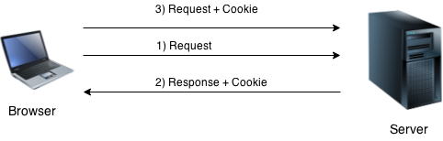
PHP Cookie

Slide 86
PHP setcookie() function
PHP setcookie() function is used to set cookie with HTTP response.
Once cookie is set, you can access it by $_COOKIE superglobal variable.
Syntax
bool setcookie ( string $name [, string $value [, int $expire = 0 [, string $path
[, string $domain [, bool $secure = false [, bool $httponly = false ]]]]]] )
Example
setcookie("CookieName", "CookieValue");/* defining name and value only*/
setcookie("CookieName", "CookieValue", time()+1*60*60);//using expiry in 1 hour(1*60*60 seconds or 3600 seconds)
setcookie("CookieName", "CookieValue", time()+1*60*60, "/mypath/", "mydomain.com", 1);

Slide 87
PHP $_COOKIE
PHP $_COOKIE superglobal variable is used to get cookie.
Example
$value=$_COOKIE["CookieName"];//returns cookie value

Slide 88
PHP Cookie Example
File: cookie1.php
<?php
setcookie("user", “xyz");
?>
<html>
<body>
<?php
if(!isset($_COOKIE["user"])) {
echo "Sorry, cookie is not found!";
} else {
echo "<br/>Cookie Value: " . $_COOKIE["user"];
}
?>
</body>
</html>
Output:
Sorry, cookie is not found!
Firstly cookie is not set. But, if you refresh the page, you will see cookie is set now.
Output:
Cookie Value: xyz

Slide 89
PHP Delete Cookie
If you set the expiration date in past, cookie will be deleted.
File: cookie1.php
<?php
setcookie ("CookieName", "", time()-3600);// set the expiration date to one hour ago
?>

Slide 90
PHP Session
PHP session is used to store and pass information from one page to another temporarily (until user close the website).
PHP session technique is widely used in shopping websites where we need to store and pass cart information e.g. username, product code, product name, product price etc from one page to another.
PHP session creates unique user id for each browser to recognize the user and avoid conflict between multiple browsers.

Slide 91
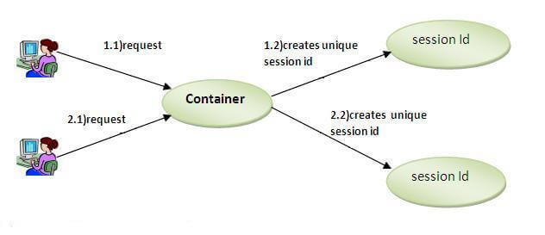
PHP Session

Slide 92
PHP session_start() function
PHP session_start() function is used to start the session.
It starts a new or resumes existing session. It returns existing session if session is created already.
If session is not available, it creates and returns new session.
Syntax
bool session_start ( void )
Example
session_start();

Slide 93
PHP $_SESSION
PHP $_SESSION is an associative array that contains all session variables. It is used to set and get session variable values.
Example: Store information
$_SESSION["user"] = "Sachin";
Example: Get information
echo $_SESSION["user"];

Slide 94
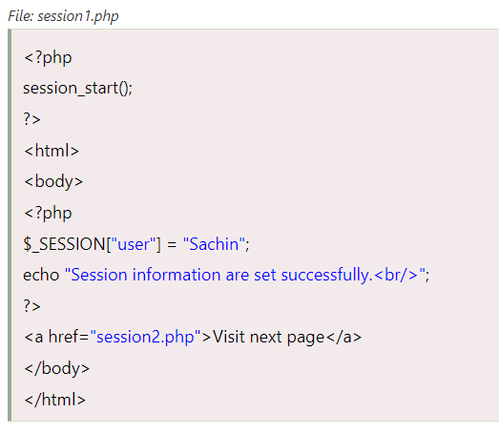
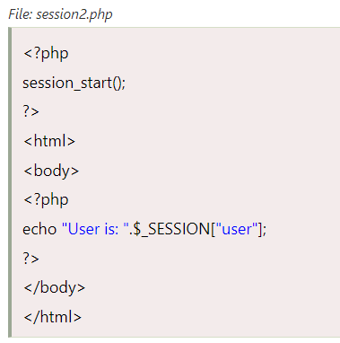
PHP Session Example

Slide 95
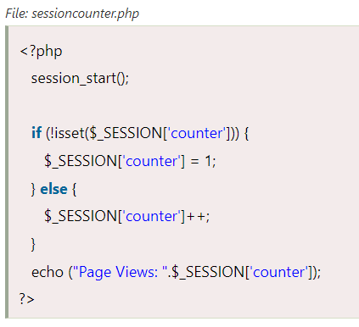
PHP Session Counter Example

Slide 96
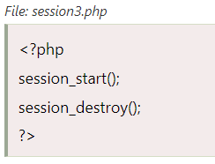
PHP Destroying Session
PHP session_destroy() function is used to destroy all session variables completely.

Slide 97
PHP File Handling
PHP File System allows us to create file, read file line by line, read file character by character, write file, append file, delete file and close file.

Slide 98
PHP Open File - fopen()
The PHP fopen() function is used to open a file.
Syntax
resource fopen ( string $filename , string $mode [, bool $use_include_path = false [, resource $context ]] )
Example
<?php
$handle = fopen("c:\\folder\\file.txt", "r");
?>

Slide 99
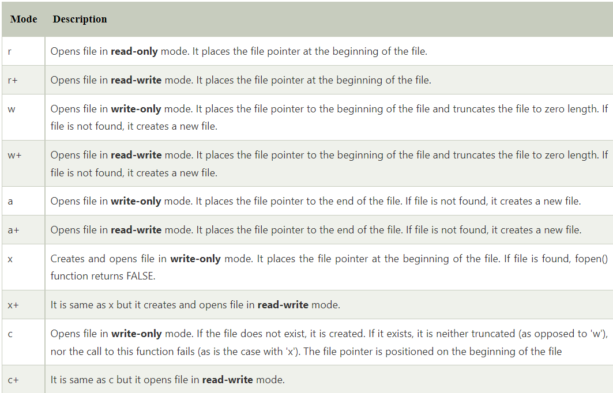
PHP Open File Mode

Slide 100
PHP Close File - fclose()
The PHP fclose() function is used to close an open file pointer.
Syntax
bool fclose ( resource $handle )
Example
<?php
fclose($handle);
?>

Slide 101
PHP Read File
PHP provides various functions to read data from file. There are different functions that allow you to read all file data, read data line by line and read data character by character.
The available PHP file read functions are given below.
fread()
fgets()
fgetc()

Slide 102
PHP Read File - fread()
The PHP fread() function is used to read the content of the file. It accepts two arguments: resource and file size.
Syntax
string fread ( resource $handle , int $length )
Example
<?php
$filename = "c:\\myfile.txt";
$handle = fopen($filename, "r");//open file in read mode
$contents = fread($handle, filesize($filename));//read file
echo $contents;//printing data of file
fclose($handle);//close file
?>

Slide 103
PHP Read File - fgets()
The PHP fgets() function is used to read single line from the file.
Syntax
string fgets ( resource $handle [, int $length ] )
Example
<?php
$fp = fopen("c:\\file1.txt", "r");//open file in read mode
echo fgets($fp);
fclose($fp);
?>

Slide 104
PHP Read File - fgetc()
The PHP fgetc() function is used to read single character from the file. To get all data using fgetc() function, use !feof() function inside the while loop.
Syntax
string fgetc ( resource $handle )
Example
<?php
$fp = fopen("c:\\file1.txt", "r");//open file in read mode
while(!feof($fp)) {
echo fgetc($fp);
}
fclose($fp);
?>

Slide 105
PHP Write File - fwrite()
The PHP fwrite() function is used to write content of the string into file.
Syntax
int fwrite ( resource $handle , string $string [, int $length ] )
Example
<?php
$fp = fopen('data.txt', 'w');//open file in write mode
fwrite($fp, 'hello ');
fwrite($fp, 'php file');
fclose($fp);
echo "File written successfully";
?>

Slide 106
PHP Delete File - unlink()
The PHP unlink() function is used to delete file.
Syntax
bool unlink ( string $filename [, resource $context ] )
Example
<?php
unlink('data.txt');
echo "File deleted successfully";
?>

Slide 107
PHP File Upload
PHP allows you to upload single and multiple files through few lines of code only.
PHP file upload features allows you to upload binary and text files both.
Moreover, you can have the full control over the file to be uploaded through PHP authentication and file operation functions.

Slide 108
PHP $_FILES
The PHP global $_FILES contains all the information of file. By the help of $_FILES global, we can get file name, file type, file size, temp file name and errors associated with file.
Here, we are assuming that file name is filename.
$_FILES['filename']['name']
returns file name.
$_FILES['filename']['type']
returns MIME type of the file.
$_FILES['filename']['size']
returns size of the file (in bytes).
$_FILES['filename']['tmp_name']
returns temporary file name of the file which was stored on the server.
$_FILES['filename']['error']
returns error code associated with this file.

Slide 109
move_uploaded_file() function
The move_uploaded_file() function moves the uploaded file to a new location.
The move_uploaded_file() function checks internally if the file is uploaded thorough the POST request. It moves the file if it is uploaded through the POST request.
Syntax
bool move_uploaded_file ( string $filename , string $destination )

Slide 110
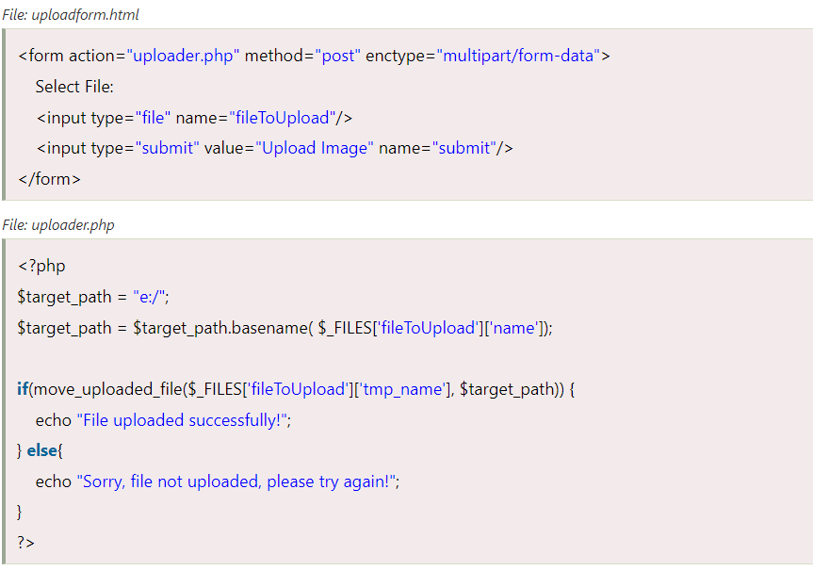
PHP File Upload Example

Slide 111
PHP Download File
PHP enables you to download file easily using built-in readfile() function.
The readfile() function reads a file and writes it to the output buffer.

Slide 112
PHP readfile() function
Syntax
int readfile ( string $filename [, bool $use_include_path = false [, resource $context ]] )
$filename: represents the file name
$use_include_path: it is the optional parameter. It is by default false. You can set it to true to the search the file in the included_path.
$context: represents the context stream resource.
int: it returns the number of bytes read from the file.

Slide 113
PHP Download File Example: Text File
<?php
$file_url = 'http://www.php.com/f.txt';
header('Content-Type: application/octet-stream');
header("Content-Transfer-Encoding: utf-8");
header("Content-disposition: attachment; filename=\"" . basename($file_url) . "\"");
readfile($file_url);
?>

Slide 114
PHP Download File Example: Binary File
<?php
$file_url = 'http://www.myremoteserver.com/file.exe';
header('Content-Type: application/octet-stream');
header("Content-Transfer-Encoding: Binary");
header("Content-disposition: attachment; filename=\"" . basename($file_url) . "\"");
readfile($file_url);
?>

Slide 115
PHP Date and Time
PHP makes it easy to work with date and time using built-in PHP date(), time(), mktime(), and strtotime() functions.
When you need a particular date and time format, PHP date() is the most important function.
PHP date() supports ‘format’ parameter that provides a wide range of formatting options according to your requirement.

Slide 116
PHP date() function
PHP date() function shows day, month and year altogether.
Date and time are stored in computer in UNIX Timestamp format.
It calculates time in number of seconds on GMT (Greenwich Mean Time) i.e started from January 1, 1970, 00:00:00 GMT.
Syntax
string date ( string $format [, int $timestamp = time() ] )

Slide 117
Parameters
Parameter | Description | Required/Optional
Format | Specifies the format of returned date and time | required
Timestamp | Current date can be used in place of timestamp | optional

Slide 118
Return
This function returns a formatted date string.
If timestamp is using a non-numeric value, FALSE is returned and an E_WARNING level error is emitted.

Slide 119
Example 1
<?php
$day =date('d/m/y');
Echo $day;
?>
Output:
09/08/18

Slide 120
Example 2
<?php
// Prints the day
echo date("l") . "\n";
// Prints the day, date, month, year, time, AM or PM
echo date("l jS \of F Y h:i:s A");
?>
Output:
Thursday
Thursday 9th of August 2018 09:16:30 AM

Slide 121
Example 3
<?php
echo date("d/m/Y") . "\n";
echo date("d-m-Y") . "\n";
echo date("d.m.Y");
?>
Output:
09/08/2018
09-08-2018
09.08.2018

Slide 122
Common date and time format characters:
Character | Description (Format)
d | Day of the month with 2 digits (leading zeros) format (01 to 31)
D | Day name of the week in three letters (Mon to Sun)
m | Month in numbers with 2 digits (01 or 12)
M | Month in three letters (Jan to Dec)
F | Month full textual representation (January to December)
y | Year in 2 digits (03 or 21)
Y | Year in 4 digits (1995 or 2020)
h | Hour in 12-hour format with 2 digits (01 to 12)
H | Hour in 24-hour format with 2 digits (01 to 24)
i | Minutes in 2 digits (00 to 59)
s | Seconds in 2 digits (00 to 59)
g | Hour in 12-hour format without leading zeros (1 to 12)
G | Hour in 24-hour format without leading zeros (1 to 24)
a | Ante meridiem and Post meridiem in Lowercase (am or pm)
A | Ante meridiem and Post meridiem in Uppercase (AM or PM)

Slide 123
Mostly used date formats in PHP:
PHP date function with useful format parameters | Output
<?php echo date("Y-m-d"); // MySQL date format ?> | 2020-06-20
<?php echo date("F j, Y, g:i A"); ?> | June 20, 2020, 3:22 PM
<?php echo date("l, F jS, Y"); ?> | Saturday, June 20th, 2020
<?php echo date("g:i:s a"); // Time only ?> | 3:22:24 pm
<?php echo date("d/m/Y"); ?> | 20/06/2020
<?php echo date("Y/m/d g:i a"); ?> | 2020/06/20 3:22 pm

Slide 124
PHP time() Function
The time() function returns the current time as a Unix timestamp, and we can pass it to date() function to change its format according to requirement.
What is PHP Timestamp?
The Timestamp is the number of seconds calculated between the current time and 1st January 1970 00:00:00 (GMT). This is also called Unix Timestamp.
Example: Using PHP time() Function
First, we will display current timestamp and date. Therefore, calculate next month timestamp and display date.

Slide 125
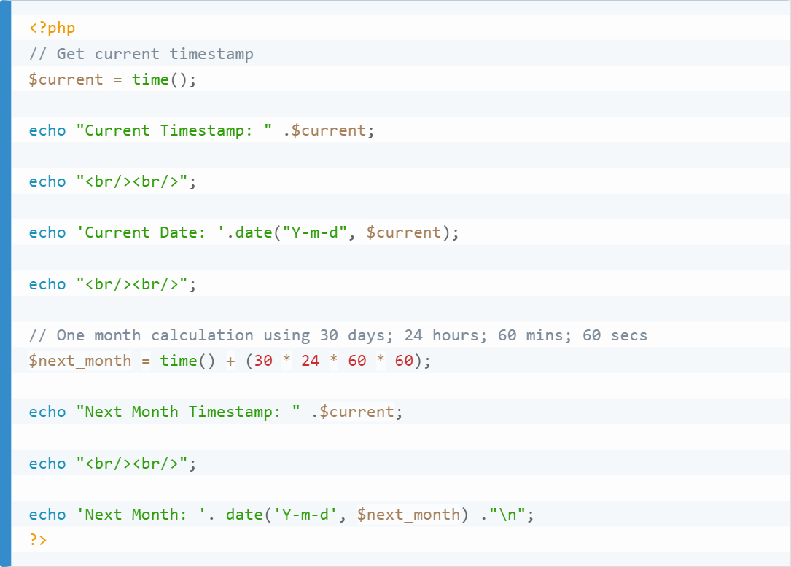
Example
Current Timestamp: 1653377773 Current Date: 2022-05-24 Next Month Timestamp: 1653377773 Next Month: 2022-06-23

Slide 126
How to Sendmail in PHP?
PHP comes with a default function mail() that allows you to sendmail directly from a PHP script.
Syntax
bool mail ( string $to , string $subject , string $message [, string $additional_headers [, string $additional_parameters ]] )

Slide 127
Parameters
to
String | Required
The email address of the recipient.
Note: The must comply with RFC 2822. You can pass one email address or multiple using comma-separated.
Few sample examples of how the values will look like:
user1@example.com
user2@example.com, user3@example.com
Receiver Name <user1@gmail.com>
Receiver Name <user1@gmail.com>, Receiver Name 2 <user2@gmail.com>

Slide 128
Parameters
subject
String | Required
The subject line of the email to be sent.
Note, the subject must comply with RFC 2047.
message
String | Required
The content of the mail that you want to send. Each line of the email should be separated with a CRLF (\r\n) and each line should not exceed 70 characters.

Slide 129
Parameters
additional_headers
mixed (String or Array) | Optional
This parameter is used to pass any additional email headers like From, Cc and Bcc. Each additional headers should be separated with a CRLF (\r\n).
Note: While sending the email, make sure there is a From header. You can set the From header, either by using the additional_headers parameter or, you can also set a default value in php.ini.

Slide 130
Parameters
additional_parameters
String | Optional
This additional_parameter can be used to pass additional flags to the Sendmail program as configured in the sendmail_path configuration setting.
For example; you can use this parameter to set the envelope sender address when using Sendmail with -f option. PHP by default internally escape the values coming in this parameter with escapeshellcmd() to prevent any potential command execution.

Slide 131
Return Value
mail() function returns TRUE if the SMTP server successfully accepted the mail for delivery, else FALSE.
Getting TRUE doesn't necessarily mean that the email is delivered to the recipient's server. TRUE is just an indication that your mail has successfully submitted to the SMTP server's queue for sending.
Note: mail() function will not work in Local server. A server connected to the internet and SMTP ports opened will be required to send mail.

Slide 132
PHP Mail Example
File: mailer.php
<?php
ini_set("sendmail_from", "sonoojaiswal@javatpoint.com");
$to = “abc1987@gmail.com";//change receiver address
$subject = "This is subject";
$message = "This is simple text message.";
$header = "From:xyz@gmail.com \r\n";
$result = mail ($to,$subject,$message,$header);
if( $result == true ){
echo "Message sent successfully...";
}else{
echo "Sorry, unable to send mail...";
}
?>

Slide 133
PHP Mail: Send HTML Message
To send HTML message, you need to mention Content-type text/html in the message header.
<?php
$to = "abc@example.com";//change receiver address
$subject = "This is subject";
$message = "<h1>This is HTML heading</h1>";
$header = "From:xyz@example.com \r\n";
$header .= "MIME-Version: 1.0 \r\n";
$header .= "Content-type: text/html;charset=UTF-8 \r\n";
$result = mail ($to,$subject,$message,$header);
if( $result == true ){
echo "Message sent successfully...";
}else{
echo "Sorry, unable to send mail...";
}
?>

Slide 134
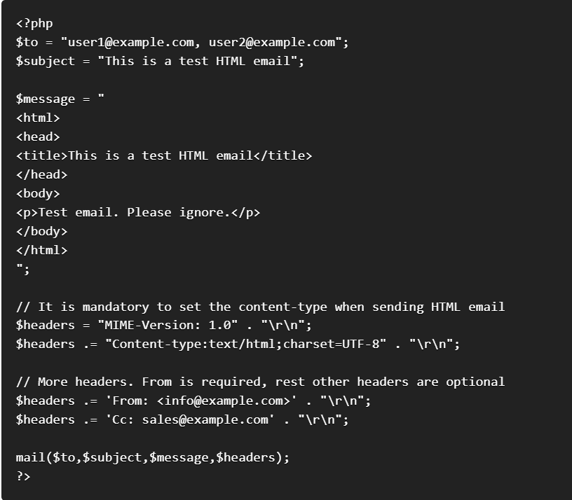
How to send an HTML mail

Slide 135
PHP Mail: Send Mail with Attachment
To send message with attachment, you need to mention many header information which is used in the example given below.
<?php
$to = "abc@example.com";
$subject = "This is subject";
$message = "This is a text message.";
# Open a file
$file = fopen("/tmp/test.txt", "r" );//change your file location
if( $file == false )
{
echo "Error in opening file";
exit();
}
# Read the file into a variable
$size = filesize("/tmp/test.txt");
$content = fread( $file, $size);
# encode the data for safe transit
# and insert \r\n after every 76 chars.
$encoded_content = chunk_split( base64_encode($content));
# Get a random 32 bit number using time() as seed.
$num = md5( time() );
# Define the main headers.
$header = "From:xyz@example.com\r\n";
$header .= "MIME-Version: 1.0\r\n";
$header .= "Content-Type: multipart/mixed; ";
$header .= "boundary=$num\r\n";
$header .= "--$num\r\n";
# Define the message section
$header .= "Content-Type: text/plain\r\n";
$header .= "Content-Transfer-Encoding:8bit\r\n\n";
$header .= "$message\r\n";
$header .= "--$num\r\n";

Slide 136
PHP Mail: Send Mail with Attachment
# Define the attachment section
$header .= "Content-Type: multipart/mixed; ";
$header .= "name=\"test.txt\"\r\n";
$header .= "Content-Transfer-Encoding:base64\r\n";
$header .= "Content-Disposition:attachment; ";
$header .= "filename=\"test.txt\"\r\n\n";
$header .= "$encoded_content\r\n";
$header .= "--$num--";
# Send email now
$result = mail ( $to, $subject, "", $header );
if( $result == true ){
echo "Message sent successfully...";
}else{
echo "Sorry, unable to send mail...";
}
?>

